Slide 1
Credential Attainment Reporting
Office of Planning, Integrity, and Compliance
Summer 2024

Slide 2
Credential Attainment – Presentation Content
Today’s presentation will cover:
What is the Credential Attainment measure?
Who is in the measure and when?
What are the types of Credentials?
How to record Credential Attainment in EmployRI?

Slide 3

Credential Attainment
Credential Attainment is one of five core performance indicators required by WIOA.
The Credential Attainment indicator is defined as the percentage of participants enrolled in an education or training program (excluding OJT and customized training) who attain a recognized postsecondary credential, industry recognized credential, or secondary school diploma, or its recognized equivalent during participation or within one year after exit from the program.

Slide 4
Credential Attainment – Who is in the measure?
In-school Youth, Out-of-School Youth, Adults, and Dislocated Workers are in the Denominator for this measure when one of the following activities are entered:
Employed Worker Skills Upgrading service;
Entrepreneurial Training (Adult Only) service;
ABE/ESL in Combination with Training service;
Registered Apprenticeship Training service;
Occupational Skills Training service;
Enrolled in Secondary Education service; OR
For Title I Youth only
School Status at Program Entry or Service Closure: Enrolled in Postsecondary School; OR
School Status at Program Entry or Service Closure: Enrolled in Secondary Education
For Real Jobs RI, generally, a participant is in the Denominator for this measure if they are receiving:
Registered Apprenticeship Training;
Occupational Skills Training (provided the training results in a recognized credential)

Slide 5

Credential Attainment– When is attainment included in the measure?
Time Frames for Inclusion in the Credential Attainment Indicator:
Credential Attainment can occur during participation or within one year after exit from the program.
The date of the most recently entered credential should be the date that it was achieved. For example, if a customer successfully completed high school on June 15, but did not provide documentation (copy of diploma or completed transcript indicating graduation) until July 1, the date of the credential should be considered June 15.

Slide 6

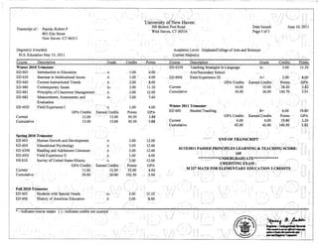
Credential Attainment - Documentation
Acceptable documentation includes:
Copy of credential (e.g., a certificate from obtaining a license or degree)
Copy of school record (e.g., year-end transcripts with the ‘Date Conferred’)

Slide 7
Credential Attainment
What credentials count for the measure?

Slide 8
Credential Attainment – What credentials count for the measure?
A credential is attained at the end of an approved education or training program that is included in an employment plan. Credential is the 'catch-all' term used to encompass:
Secondary School Credentials
Diplomas
GED
Postsecondary Credentials
Postsecondary Degrees
Professional Licenses
Industry-Recognized Certifications

Slide 9
Credential Attainment – What credentials count for the measure?
Secondary School Credentials: A secondary school diploma or its recognized equivalent recognized by the state and included for accountability under the Elementary and Secondary Education Act of 1965, as amended by the Every Student Succeeds Act.
Examples of Secondary School Credentials:
High School Diploma
High School Equivalency Diploma (HSED)
General Education Diploma (GED)
National External Diploma Program (NEDP)
Examples of what would not count as a Secondary School credential:
Special education certificate (Enrollment and attainment is still tracked for other purposes)

Slide 10
Credential Attainment – What credentials count for the measure?
Post-Secondary Credentials: A credential awarded in recognition of an individual's attainment of measurable technical or industry/occupation-specific skills necessary to obtain employment or advance within an industry/occupation. These skills are generally based on standards developed or endorsed by employers or industry associations (degrees, occupational licensure, occupational certificates, etc.). Examples of Post-secondary credentials:
Associate's Degree
Bachelor's Degree
Vocational/Technical license, diploma or certificate
An industry-recognized certificate or certification (e.g. Microsoft Information Technology certificate, Certified Nursing Assistant, certificate in business administration, Certified Welder, Commercial Driver's License)
License recognized by state or federal government (e.g. Registered Nurse, 192 Asbestos Inspector, Cosmetologist, Master Plumber, Licensed Professional Counselor)
Technical Diploma
Other education or training diploma, degree, or certificate (e.g. Job Corps certificate of completion for career technical training)
Apprenticeship certificate/diploma (e.g. youth apprenticeship or apprenticeship)

Slide 11
Credential Attainment – What credentials DON’T count for the measure?
Examples of what would not count as a Post-Secondary School credential:
Continuing Education Units (CEUs)
Disability Skills Training (Sign language, Speech Reading, cognitive training/retraining)
On-the-Job Training (OJT)
Certificates of completion
Work/Career readiness certificates (e.g. completion of soft skills training, time management training, financial literacy training, pre-occupational and introductory programs that provide a pathway to, but do not directly result in, employment in an occupation)
Workforce Development Board awarded certificates
General skill certificates related to safety or hygiene, etc. (e.g. CPR, OSHA, Emergency Management, ServSafe)
Credentials that are not industry-recognized or sought by a specific industry or occupation (e.g. college certificates such as Professional Communication, Public Speaking, Global Studies, Bilingual Spanish Skills)

Slide 12
Questions and Answers
Q: What is an industry recognized credential?
A: Industry recognized credentials are sought or accepted by employers within the industry or sector involved, and are a recognized or required credential for recruitment, screening, hiring, retention, or advancement purposes. They may include occupational skills certificates, diplomas, degrees, certificates, or licenses.
Q: May an individual employer issue a credential?
A: No. Individual employers are not recognized in the list of approved credentials as they are not transferable to other employers.
Q. May I record a graduate degree as a credential?
A: No. Per USDOL TEGL 10-16, Change 3, graduate degrees do not count toward the Credential Attainment Rate for WIOA Title I participants.

Slide 13
Questions and Answers
Q. Would a Workforce Development Board (WDB) approved credential be reported as a credential?
A: No. WDB issued or approved credentials do not meet the definition of credential, even if
there is local policy stating otherwise.
Q: May the National Career Readiness Credential be reported as a credential?
A: No. While the NCRC is a popular credential for many employers, it is not unique to a specific
occupation and per USDOL guidance, it cannot be recognized as a credential.
Q: Does completion of OJT count as a credential?
A: Completion of an OJT does not count as a credential. However, participants are excluded
from the credential performance measure if they only receive OJT.
Q: Can a certificate of attendance or a sign-in sheet be used to verify a credential?
A: No. A certificate of attendance or sign in sheet does not verify credential attainment.

Slide 14
Questions and Answers
Q: Does a Cardiopulmonary Resuscitation (CPR) certificate or Occupational Safety and Health
Administration (OSHA) certificate count as a credential?
A: No. While CPR or OSHA training may provide benefit to participants as they begin to gain
general knowledge about occupations and occupational standards, participants are unlikely to
gain employment or advance within an occupation based solely upon receiving a CPR or OSHA
certificate. Therefore, CPR and OSHA certificates may not be reported as credentials.
Q: Does a ServSafe certificate count as a credential?
A: There are multiple certificates and certifications from ServSafe. The Food Handler
certification does not meet the required USDOL criteria of a credential because it is not unique
to, nor lead to, employment in a specific occupation. Therefore, for those participants enrolled
in the WIOA, ServSafe Food Handler certificates may not be reported as credentials.
However, the ServSafe Food Protection Manager certification has been determined to meet the
USDOL definition for credential because it can lead to employment in that specific occupation.

Slide 15
Questions and Answers
Q: What if a participant successfully completes a college degree in August, but the university
only issues diplomas in December and May?
A: The student’s transcript will list the date of degree attainment as a date in August following
completion of courses. This is the preferred method of reporting for such participants.
Q: Can I use an unofficial HSE transcript to verify credential attainment?
A: No. The unofficial transcript does not have the date of attainment, which is required to report
the credentials.
Q: Does completion of a Microsoft Word, Excel, or similar program count as a credential?
A: No. These single skill certificates do not count as credentials.
Q: Does a National Retail Federation certification count as a credential?
A: Yes. Per the USDOL correspondence, this certification is an acceptable credential.

Slide 16




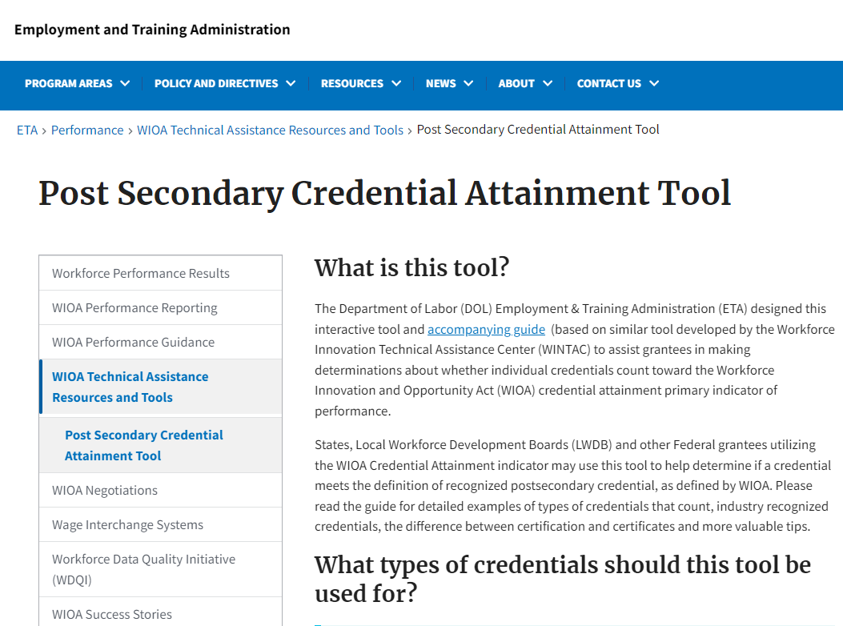
Still Unsure?
Remember that Credentials are:
Industry Recognized: Developed and offered by nationally/regionally recognized industry association or organization and accepted for purposes of hiring or recruitment.
Stackable: Part of a sequence of credentials that build up an individual’s qualifications and assists in moving along a career pathway.
Portable: Recognized and accepted as verifying qualifications in multiple settings.
Accredited: Recognition by an independent, quality‐review body is a valuable attribute and may be required by some institutions or programs.
You can always ask:
Your supervisor or program manager
Your partnership advisor (Real Jobs RI)
Our office
Or visit: https://www.dol.gov/agencies/eta/Performance/resources/credential-attainment

Slide 17
Credential Attainment
Recording Credential Attainment in EmployRI

Slide 18

Recording Credential Attainment in EmployRI
Navigation
An approved credential should be entered in the credentials bar of the WIOA application. A credential, or credentials, can be added in the WIOA Program screen under:
Staff Profile>Case Management Profile>Programs>Credentials>Create Credential
Requirements
The service that led to the credential should be closed before adding the credential. For example, if it the credential was earned through an Occupational Classroom Training (ITA) service, the service must be closed in EmployRI before entering a credential. There should also be a case note indicating that the participant has completed training and the approved credential has been attained. In addition, a credential can be added up to a year after the participation date even if the participant is already exited.

Slide 19
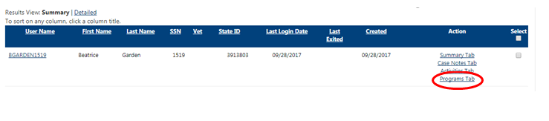
Recording Credential Attainment in EmployRI
Step 1:
Under Manage Individuals click on Assist an Individual and search for your customer. Click on the Programs Tab link located on the right-hand side.

Slide 20

Recording Credential Attainment in EmployRI
Step 2:
On the Program Tab scroll down to the WIOA application and click on the plus sign to expand the application tabs. Once the application has been expanded scroll down toward the middle of the page and click on the plus sign of the Credentials Bar.

Slide 21
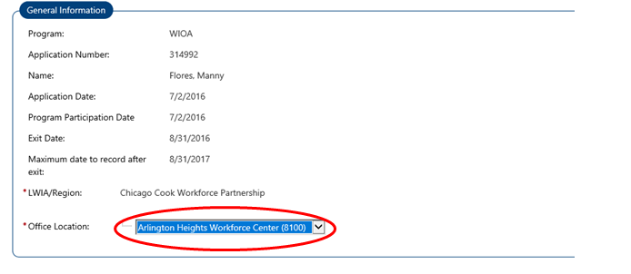
Recording Credential Attainment in EmployRI
Step 3:
When you are on the Credentials bar click on Create Credential. Under the General Information Tab select the Office Location.

Slide 22
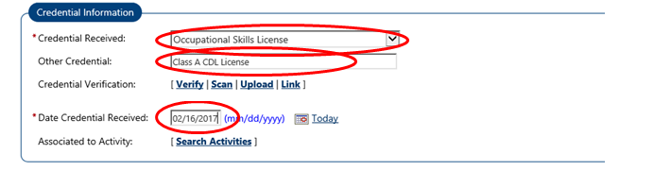
Recording Credential Attainment in EmployRI
Step 4:
Scroll down to the Credential Information Section. Complete all 4 fields as follows:
Select the “Credential Received”
Under “Other Credential” specify what entity issued the credential and the name of the credential.
Select the appropriate verification documentation used to verify the credential
Enter the Date the Credential was attained under “Date Credential Received”

Slide 23
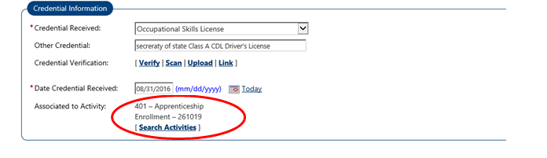
Recording Credential Attainment in EmployRI
Step 5:
Click on “Search Activities” to indicate which WIOA service led to the credential.

Slide 24
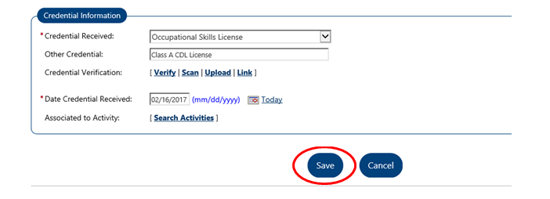
Recording Credential Attainment in EmployRI
Step 6:
Once the credential information has been entered click Save to save the credential in EmployRI.

Slide 25
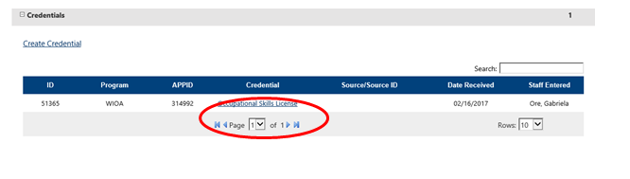
Recording Credential Attainment in EmployRI
Step 7:
Once you click Save, the system will take you back to the Credentials bar and you will see your credential has been added to the participant’s application.
The credential will now be recorded properly and the credential will count towards the Credential Attainment performance measure.

Slide 26
Credential Attainment Reporting
Office of Planning, Integrity, and Compliance
Summer 2024

