Slide 1


Measurable Skill Gains (MSG) Reporting
Office of Planning, Integrity, and Compliance
August 2023
Notes:
Slide 1: Welcome to the Measurable Skill Gains (MSG) Reporting technical assistance presentation given by the Office of Planning, Integrity and Compliance also known as OPIC.

Slide 2
Measurable Skill Gain – Presentation Content
Today’s presentation will cover:
What is a Measurable Skill Gain?
Who is included in the measure and when are they included?
What are the types of Skill Gains?
How to record Measurable Skill Gains in EmployRI?
Notes:
Slide: 3 Measurable Skills Gain- Presentation Content
Today’s Content will focus on a required but often complicated core performance metric: Measurable Skills Gain.
The presentation will cover:
What is a Measurable Skill Gain?
Who is included in the measure and when are they included?
What are the types of Skill Gains?
How to record Measurable Skill Gains in EmployRI?

Slide 3

Measurable Skill Gain
The Workforce Innovation and Opportunity Act (WIOA) establishes primary indicators of
performance and performance reporting requirements to assess the effectiveness of states and
local areas in achieving positive outcomes for individuals served by the workforce development
system’s programs, which include Adult, Dislocated Worker (DW), and Youth programs
authorized under WIOA Title I. Measurable Skill Gains (MSG) is one of these primary indicators
of performance.
The MSG indicator is the percentage of program participants who, during a program year:
are in an education or training program that leads to a recognized postsecondary credential or employment; and
achieve documented progress in attaining academic, technical, occupational, or other forms of progress towards that credential or employment.
Notes:
Slide: 5 Measurable Skill Gain
The Workforce Innovation and Opportunity Act (WIOA) establishes primary indicators of
performance and performance reporting requirements to assess the effectiveness of states and
local areas in achieving positive outcomes for individuals served by the workforce development
system’s programs which include Adult, Dislocated Worker (DW), and Youth programs
authorized under WIOA Title I. Measurable Skill Gains (MSG) is one of these primary indicators
of performance.
WIOA establishes five primary indicators of
performance for participants. Measurable Skill Gains (MSG) is one of these primary indicators
The MSG indicator is the percentage of program participants who, during a program year:
are in an education or training program that leads to a recognized postsecondary credential or employment; and
achieve documented progress in attaining academic, technical, occupational, or other forms of progress towards that credential or employment.

Slide 4
Who is included in Measurable Skill Gain?
Notes:
Slide: 5 Who is included in Measurable Skill Gain?

Slide 5

Measurable Skill Gain – Who is in the measure?
Participants in the MSG indicator include:
WIOA Adult or DW participants enrolled in approved training programs that lead to a credential;
WIOA Adult and DW participants who are enrolled in a training program that leads to a High School Equivalency (HSE);
WIOA Adult and DW participants enrolled in On-the-Job Training (OJT) and Customized Training;
WIOA In-School Youth participants; and
Certain Out-of-School Youth participants enrolled in occupational skills training, or secondary or postsecondary education.
Notes:
Slide 6: Measurable Skill Gain – Who is in the measure?
Participants who ‘count’ within the MSG indicator include:
WIOA Adult or DW participants enrolled in approved training programs that lead to a credential;
WIOA Adult and DW participants who are enrolled in a training program that leads to a High School Equivalency (HSE);
WIOA Adult and DW participants enrolled in On-the-Job Training (OJT) and Customized Training;
WIOA In-School Youth participants; and
Certain Out-of-School Youth participants enrolled in occupational skills training, or secondary or postsecondary education.

Slide 6
Measurable Skill Gain – Who is in the measure?
  All In-school Youth
  2. Out-of-School Youth who, during a Program Year (PY) enroll in a training program or secondary or post-secondary (high school or college-level) education leading to a diploma, high school equivalency, or certification. The participant must be enrolled in one of the following EmployRI services. (Note: EmployRI activity code numbers are listed for each.)
  415- Alternative Secondary School Training
  416- Occupational Skills Training
  418- Adult Education (GED)
  429- Enrolled in Secondary School (H.S.)
  430- Youth Occupational Skill Training – Non-approved
  436- Entrepreneurial Skills Training
Notes:
Slide 7: Measurable Skill Gain – Who is in the measure?
More Specifically, The Measurable Skill Gain Indicator applies to:
1. All In-school Youth
2. Out-of-School Youth who, during a Program Year (PY) enroll in a training program or secondary or post-secondary (high school or college-level) education leading to a diploma, high school equivalency, or certification. The participant must be enrolled in one of the following services:
415- Alternative Secondary School Training
416- Occupational Skills Training
418- Adult Education (GED)
429- Enrolled in Secondary School (H.S.)
430- Youth Occupational Skill Training – Non-approved
436- Entrepreneurial Skills Training

Slide 7
Measurable Skill Gain – Who is in the measure? Cont’d
3. Adults and Dislocated Workers who, during a Program Year (PY), are enrolled in one of the EmployRI training services. (Note: EmployRI activity code numbers are listed for each)
  222- English as a Second Language (ESL)
  214 Adult Literacy, Basic Skills or GED Preparation
  300-Occupational Classroom Training (ITA) - Approved Provider List
  301-On-the-Job Training (OJT)
  302-Entrepreneurial Training
  304-Customized Training
  314-Enrolled in Apprenticeship Training
  324-Adult Educ w/ Occ. Skills Training -Approved Provider List (ITA)
  328-Occupational Skills Training – Non-approved Provider (no ITA)
  333-TAA - Approved Remedial Training (for those with GED/HS Diploma)
  334- TAA Prerequisite Training
  335- TAA - Approved Occupational Skills Training - Approved by Other State
  339-TAA - Approved GED Training
  341- TAA-Approved Remedial Training (for those with GED HS Diploma)- Approved by Other State
  375 IWT - Incumbent Worker Training
Notes:
Slide: 8 Measurable Skill Gain – Who is in the measure? Cont’d
3. Adults and Dislocated Workers who, during a Program Year (PY), are enrolled in one of the following training services:
222- English as a Second Language (ESL)
214 Adult Literacy, Basic Skills or GED Preparation
300-Occupational Classroom Training (ITA) - Approved Provider List
301-On-the-Job Training (OJT)
302-Entrepreneurial Training
304-Customized Training
314-Enrolled in Apprenticeship Training
324-Adult Educ w/ Occ. Skills Training -Approved Provider List (ITA)
328-Occupational Skills Training – Non-approved Provider (no ITA)
333-TAA - Approved Remedial Training (for those with GED/HS Diploma)
334- TAA Prerequisite Training
335- TAA - Approved Occupational Skills Training - Approved by Other State
339-TAA - Approved GED Training
341- TAA-Approved Remedial Training (for those with GED HS Diploma)- Approved by Other State
375 IWT - Incumbent Worker Training

Slide 8
When is the Measurable Skill Gain included?
Notes:
Slide: 9 When is the Measurable Skill Gain included?
We established WHO the Measurable Skill Gain metric applies to. Now let’s discuss WHEN a Measurable skill gain is achieved and documented.

Slide 9

Measurable Skill Gain – When is attainment included in the measure?
Time Frames for Inclusion in the MSG Indicator:
Skills Gains are based on the Program Year (July 1-June 30) and NOT on the Exit date. This means that Skills Gain is a live, ‘in-program’ measure.
Adult, Dislocated Worker and Out-of-School Youth customers are ‘in’ the measure each year they participate in WIOA and are enrolled in training or education (i.e. have an open training service/education service as defined previously).
If the training/education service dates span multiple program years, then the participant is in the measure each year.
Notes:
Slide:10 Measurable Skill Gain- When is attainment included in the measure?
Time Frames for Inclusion in the MSG Indicator:
Importantly… unlike earnings or employment metrics which are tracked post-exit Measurable Skills Gains are based on the Program Year (July 1-June 30) and NOT on the Exit date. This means that Skills Gain is a live, ‘in-program’ measure.
Adult, Dislocated Worker and Out-of-School Youth customers are ‘in’ the measure each year they participate in WIOA and are enrolled in training or education (i.e. have an open training service/education service as defined previously).
If the training/education service dates span multiple program years, then the participant is in the measure each year.

Slide 10
Measurable Skill Gain – When is attainment included in the measure?
EXAMPLES:
If Susie started Occupational Classroom Training in May of 2019 (PY18) and completed training in Oct 2019 (PY19), she would be included in the measure in both PY18 and PY19.
If William participates in training from January-May 2019 (PY18) but continues to receive job placement services through August 2019 (PY19), he is only included in the measure in PY18.
Agencies and providers must close complete training/education services in a timely manner to ensure that participants are removed from the measure upon training completion.
Participants who are enrolled in training/education are included in the measure regardless of how long they have participated in the Program Year. For example, if a participant is enrolled on June 18th, they have until June 30th to achieve a gain.
In accordance with USDOL guidance, “Programs should not delay enrollment or services to participants until a new program year even if programs believe there is insufficient time for the participant to make any type of measurable skill gain by the end of that program year.”
Notes:
Slide 11: Measurable Skill Gain- When is attainment included in the measure? (Some examples)
Lets say Susie started Occupational Classroom Training in May of 2019 (PY18) and completed training in Oct 2019 (PY19), she would be included in the MSG measure in both PY18 and PY19 because she was active in that training for both program years.
Now lets say William participates in training from January-May 2019 (PY18) but continues to receive job placement services all the way through August 2019 (PY19). Because the training activity concluded in PY18 he is only included in the MSG measure in PY18.
For this reason; agencies and providers must close complete training/education activities in a timely manner to ensure that participants are removed from the MSG measure upon training completion.
Participants who are enrolled in training/education are included in the measure regardless of how long they have participated in the Program Year. So, for example, if a participant is enrolled in training on June 18th, they have until June 30th to achieve a gain for it to count for the program year.
With that said; In accordance with USDOL guidance, “Programs should not delay enrollment or services to participants until a new program year even if programs believe there is insufficient time for the participant to make any type of measurable skill gain by the end of that program year.”

Slide 11
What Measurable Skill Gains are included?
Notes:
Slide 12: What Measurable Skill Gains are included?

Slide 12
Measurable Skill Gain – What are the types of Skill Gains?
Skill Gains are measured by five Skill Types:
Post-Secondary Transcript/ Report Card
Secondary Transcript/ Report Card
Training Milestone
Skills Progression
Educational Functioning Level (EFL)
(two ways)
Although multiple gains may be entered for a client in a program year (July 1-June 30), only one gain will count towards performance per year.
Notes:
Slide 13: What are the types of Skill Gains?
There are FIVE types of Measurable Skill Gains that can be attained.
Progress documented on a Post-Secondary Transcript/ Report Card
Progress documented on Secondary Transcript/ Report Card
Achievement of a Training Milestone
Skills Progression; and
Attainment of a new Educational Functioning Level (EFL) (which is itself attainable in two ways)
*** Although multiple gains may be entered for a client in a program year (July 1-June 30), only one gain will count towards performance per year.

Slide 13

Measurable Skill Gain – What are the types of Skills Gains?
Post-Secondary Transcript/Report Card:
Applies to participants enrolled in post-secondary education
Full-time students must complete a minimum of 12 hours per semester during the WIOA program year (July 1 - June 30)
Part-time students must complete a total of at least 12 credit hours over the course of two completed consecutive semesters during the WIOA program year
Allowable documentation: Transcript or Report Card that shows a participant is meeting the State unit’s academic standards. The documentation must include whether the participant is enrolled full- or part-time. It must not show that the participant dropped out or was removed on academic or conduct grounds.
Notes:
Slide 14: What are the types of Skills Gains?
“Progress documented on a Post-Secondary Transcript/Report Card:
This Applies to participants enrolled in post-secondary education
Full-time students must complete a minimum of 12 hours per semester during the WIOA program year (July 1 - June 30) to count
Part-time students must complete at least 12 credit hours over the course of two completed consecutive semesters during the WIOA program year to count;
Allowable documentation: For this MSG is a Transcript or Report Card that shows a participant is meeting the schools academic standards. The documentation must indicate whether the participant is enrolled full- or part-time. It must not show that the participant dropped out or was removed on academic or conduct grounds. For example,

Slide 14
Measurable Skill Gain – What are the types of Skills Gains? Cont’d
Secondary Transcript/Report Card:
Applies to participants without a high school diploma or equivalency at program entry
Allowable Documentation: Participant’s secondary school transcript or report card for one semester showing that the participant demonstrating satisfactory achievement in all classes. It must not show that the participant dropped out or was removed on academic or conduct grounds. The semester must be within the Program Year.
Notes:
Slide 15: What are the types of Skills Gains? Cont’d.
The second MSG is Progress documented on a Secondary Transcript/Report Card:
This Applies to participants without a high school diploma or equivalency at program entry Allowable Documentation for this MSG is Participant’s secondary school transcript or report card for one semester showing that the participant demonstrating satisfactory achievement in all classes. It must not show that the participant dropped out or was removed on academic or conduct grounds. The semester must occur within the Program Year.

Slide 15

Measurable Skill Gain – What are the types of Skills Gains? Cont’d
Training Milestone:
Participant made satisfactory or better progress towards established milestones, such as completion of OJT or completion of one year of an apprenticeship program or similar milestones.
Allowable Documentation: Satisfactory or better progress report from an employer or training provider that is providing training (e.g., training reports showing completed milestones, increases in pay resulting from new skills, or increased performance.)
Notes:
Slide 16: What are the types of Skills Gains? Cont’d.
The third MSG is one that may require a bit of forethought when securing a training opportunity or OJT for a participant and that is ‘Achievement of Training Milestone.
A Training Milestone is achieved when:
A Participant had made satisfactory or better progress towards established training milestones, such as completion of an OJT or completion of one year of an apprenticeship program or attainment of an important competenciy in a training, etc.
Allowable Documentation: includes a Satisfactory or better progress report from an employer or training provider that is providing training (e.g., training reports showing completed milestones, increases in pay resulting from new skills, or increased performance.) Of course, to secure such documentation, you will need to make sure on the frontend that the training provider or sponsoring employer is prepared to produce and provide such a document.

Slide 16

Measurable Skill Gain – What are the types of Skills Gains? Cont’d
Skills Progression:
Participant successfully passes an exam that is required for an occupation or progress in attaining technical or occupational skills as evidenced by trade-related benchmarks, such as knowledge-based exams and/or a diploma. (e.g., employer knowledge-based exam, occupational competency assessment, test necessary to obtain a credential.)
Allowable Documentation: Copy of results of exam, test or assessment or copy of diploma or certificate.
Notes:
Slide 17: What are the types of Skills Gains? Cont’d
The fourth MSG is a bit easier to document depending on the participant circumstance and that is Skills Progression:
Skills progression is documented when a Participant successfully passes an exam that is required for an occupation or progresses
in attaining technical or occupational skills as evidenced by trade-related benchmarks, such as knowledge-based exams and/or a diploma. (e.g., employer knowledge-based exam, occupational competency assessment, test necessary to obtain a credential.)
Allowable Documentation: Copy of results of exam, test or assessment or copy of diploma or certificate.

Slide 17

Measurable Skill Gain – What are the types of Skills Gains? Cont’d
Educational Functioning Level (EFL): An individual can achieve an EFL gain for MSG in one of two ways:
1) Test Scores: A Participant who is below post-secondary grade level at program entry and achieves a gain of at least one EFL on an acceptable Adult Basic Education (ABE) or English as a Second Language (ESL) post-test.
Allowable Documentation: Pre- and post-ABE or ESL test. [NOTE: EFL gains are calculated based on test scores entered on the WIOA “Educational Functioning Level for Measurable Skills Gains” bar in EmployRI]
2) EFL Gain by Entry into Post-Secondary Education: The EFL gain for entry into post-secondary education applies to Exiters who:
received a qualifying training/education service, AND
whose school status at exit is “Not attending school; H.S. Graduate”, AND
who enter Post-Secondary education or training after exit, but during the same program year as the qualifying training/education service.
Notes:
Slide 18: What are the types of Skills Gains? Cont’d.
The final MSG, Educational Functioning Level (EFL), can be achieved in one of two ways:
The first is Test Scores: in which case A Participant who is below postsecondary grade level at program entry achieves a gain of at least one EFL on an acceptable Adult Basic Education (ABE) post-test or English as a Second Language (ESL) post-test.
Allowable Documentation: includes both Pre- and post-ABE or ESL test. [NOTE: EFL gains are calculated based on test scores entered on the WIOA
“Educational Functioning Level for Measurable Skills Gains” bar in EmployRI, which we will get into in later slides.
The second EFL Gain is achieve through Entry into Post-Secondary Education: The EFL gain for entry into post-secondary education applies to
Exiters who:
received a qualifying training/education service, AND
whose school status at exit is “Not attending school; H.S. Graduate”, AND
•who enter Post-Secondary education or training after exit, but during the same program year as the qualifying training/education service.

Slide 18
How are Measurable Skill Gains recorded in EmployRI?
Notes:
Slide 19: How are Measurable Skill Gains recorded in EmployRI?
We have literally covered the WHO, WHAT, and WHEN of measurable skill gain reporting. Now we will discuss how Measurable Skill Gains are recordedin EmployRI. OPIC emphasize that the process is not necessarily simple. But with access to this guidance and repetition, it can be made easy.

Slide 19

Recording Measurable Skill Gains in EmployRI
Post-Secondary Transcript/ Report Card
Secondary Transcript/ Report Card
Training Milestone
Skills Progression
Educational Functioning Level (EFL)
(two ways)
ABE / ESL Test Scores
Entry into Post-Secondary Education
Notes:
Slide 20: Recording Measurable Skills Gains in EmployRI cont’d.
Let’s review how to record an Education Functioning Level gain made on a pre and post test for Adult Basic Education ( ABE) or English as Second Language ( ESL.).

Slide 20
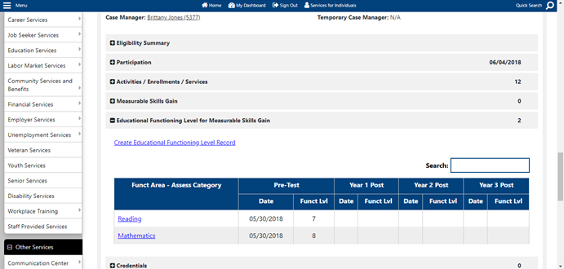
Recording Measurable Skill Gains in EmployRI
Entering Educational Functioning Level (EFL) Gains (ABE and ESL): EFL gains for ABE and ESL test scores are recorded in Staff Profile > Case Management Profile > Programs > Educational Functioning Level for Measurable Skill Gain bar.
Pre-Test
Step 1:
Click on the “Create Educational Functioning Level Record” link.”.
Notes:
Slide 21: Recording Measurable Skills Gains in EmployRI (Entering Pre-Test Scores)
To enter EFL gains for (Adult Basic Education) ABE and English Second Language (ESL) test scores the file path you will use is
Staff Profile > Case Management Profile > Programs > Educational Functioning Level for Measurable Skill Gain bar.
Step 1: Having brought up the participant’s case; Click on the “Create Educational Functioning Level Record” link (Pre-test)

Slide 21
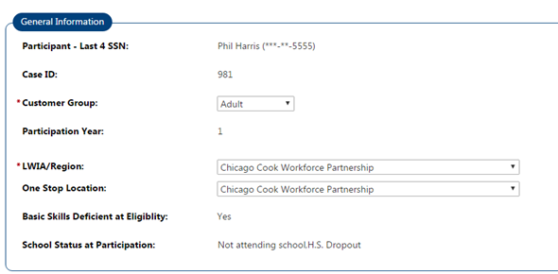
Recording Measurable Skill Gains in EmployRI
Entering Educational Functioning Level (EFL) Gains (ABE and ESL): EFL gains for ABE and ESL test scores are recorded in Staff Profile > Case Management Profile > Programs > Educational Functioning Level for Measurable Skill Gain bar.
Pre-Test
Step 2:
Data in the General Information section will be pre-filled.
Notes:
Slide 22: Recording Measurable Skills Gains in EmployRI (Entering Pre-Test Scores)
Educational Functioning Level (EFL) Gains (ABE and ESL): EFL gains for ABE and ESL test scores are recorded in (file path)
Staff Profile > Case Management Profile > Programs > Educational Functioning Level for Measurable Skill Gain bar.
Step 2: Data in the General Information section will be pre-filled.

Slide 22
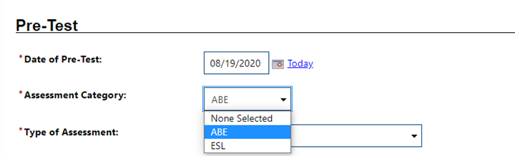
Recording Measurable Skill Gains in EmployRI
Entering Educational Functioning Level (EFL) Gains (ABE and ESL): EFL gains for ABE and ESL test scores are recorded in Staff Profile > Case Management Profile > Programs > Educational Functioning Level for Measurable Skill Gain bar.
Pre-Test
Step 3:
In the Pre-Test section, add the Pre-Test date – the exact date that the test was administered. The date cannot be more than 6 months prior to the WIOA eligibility date or 1 year prior to the Actual Start Date of the first training service
Step 4:
Select the Assessment Category:
• ABE = Adult Basic Education
• ESL = English as a Second Language
Notes:
Slide 23: Recording Measurable Skill Gains in EmployRI. (Entering Pre-test Scores)
Entering Educational Functioning Level (EFL) Gains (ABE and ESL): EFL gains for ABE and ESL test scores are recorded in (file path)
Staff Profile > Case Management Profile > Programs > Educational Functioning Level for Measurable Skill Gain bar.
Step 3:
In the Pre-Test section, add the Pre-Test date, (which is the exact date that the pre-test was administered)
After entering the pre-test date, Select the type of Assessment Category: Either
• ABE = Adult Basic Education
• ESL = English as a Second Language
AND Step 4:
Select the Assessment Category:
• ABE = Adult Basic Education
• ESL = English as a Second Language

Slide 23
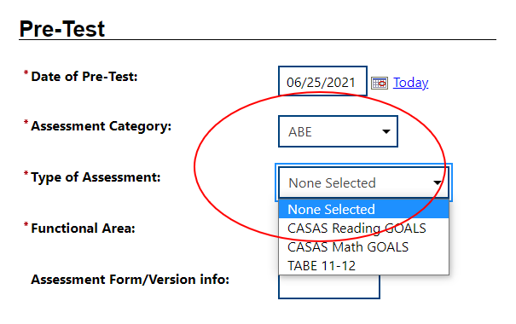
Recording Measurable Skill Gains in EmployRI
Entering Educational Functioning Level (EFL) Gains (ABE and ESL): EFL gains for ABE and ESL test scores are recorded in Staff Profile > Case Management Profile > Programs > Educational Functioning Level for Measurable Skill Gain bar.
Pre-Test
Step 5:
Select the Type of Assessment.
Step 6:
Select the Functional Area:
Reading
Mathematics
Language
Notes:
Slide 24: Recording Measurable Skill Gains in EmployRI (Entering Pre-Test Scores)
Entering Educational Functioning Level (EFL) Gains (ABE and ESL): EFL gains for ABE and ESL test scores are recorded in (file path)
Staff Profile > Case Management Profile > Programs > Educational Functioning Level for Measurable Skill Gain bar.
Step 5: In the Pre-Test section, add the Pre-Test date, (which is the exact date that the pre-test was administered)
After entering the pre-test date,
Select the type of Assessment Category: Either
• ABE = Adult Basic Education
• ESL = English as a Second Language
Step 6: Select the Type of Assessment that was administered and the Functional Area that was assessed
Reading
Mathematics
Language

Slide 24
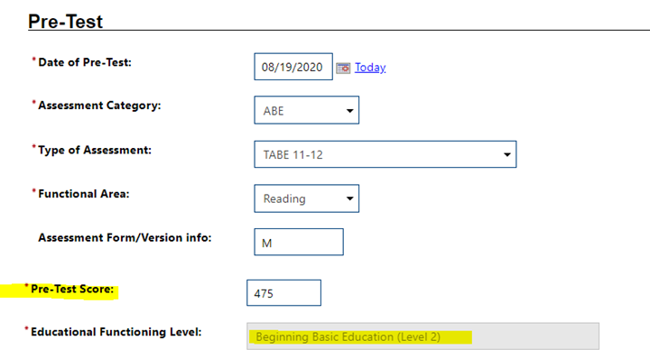
Recording Measurable Skill Gains in EmployRI
Entering Educational Functioning Level (EFL) Gains (ABE and ESL): EFL gains for ABE and ESL test scores are recorded in Staff Profile > Case Management Profile > Programs > Educational Functioning Level for Measurable Skill Gain bar.
Pre-Test
Step 7:
Add the Pre-Test score. The system will automatically calculate the Educational Functioning Level.
Step 8:
Scroll to the bottom of the screen & click “Save”.
Notes:
Slide 25: Recording Measurable Skill Gains in EmployRI (Entering Pre-test Scores)
Entering Educational Functioning Level (EFL) Gains (ABE and ESL): EFL gains for ABE and ESL test scores are recorded in (file path)
Staff Profile > Case Management Profile > Programs > Educational Functioning Level for Measurable Skill Gain bar.
Step 7: Add the Pre-Test score. The system will automatically calculate the Educational Functioning Level.
Step 8: Scroll to the bottom of the screen & click “Save”
You’ve now entered the PRE-test EFL… eventually it will become time to enter the Post-test EFL and hopefully a measurable skill gain was achieve.

Slide 25
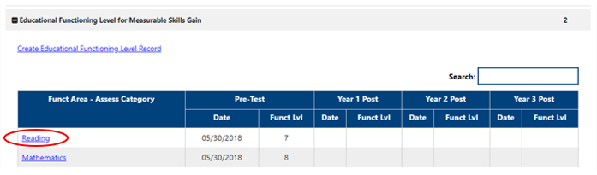
Recording Measurable Skill Gains in EmployRI
Entering Educational Functioning Level (EFL) Gains (ABE and ESL): EFL gains for ABE and ESL test scores are recorded in Staff Profile > Case Management Profile > Programs > Educational Functioning Level for Measurable Skill Gain bar.
Post-Test
Step 1:
Click an existing assessment link within the Educational Functioning Level Record to access the screen to add a Post-test.
Notes:
Slide 26: Recording Measurable Skill Gains in EmployRI ( Enter Post Test Scores)
You will use the same file path in EmployRI as you did when entering pre-test scores. File path: Staff Profile > Case Management Profile > Programs > Educational Functioning Level for Measurable Skill Gain bar.
Step 1: Click an existing assessment link within the Educational Functioning Level Record to access the screen to add a Post-test.

Slide 26
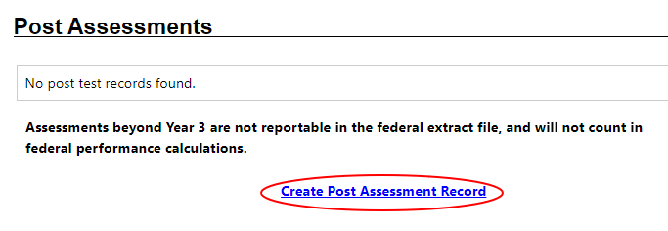
Recording Measurable Skill Gains in EmployRI
Entering Educational Functioning Level (EFL) Gains (ABE and ESL): EFL gains for ABE and ESL test scores are recorded in Staff Profile > Case Management Profile > Programs > Educational Functioning Level for Measurable Skill Gain bar.
Post-Test
Step 2:
Scroll down to the bottom of the page and click the “Create Post Assessment Record” link.
Notes:
Slide 27: Recording Measurable Skill Gains in EmployRI
Entering Educational Functioning Level (EFL) Gains (ABE and ESL): EFL gains for ABE and ESL test scores are recorded in (file path)
Staff Profile > Case Management Profile > Programs > Educational Functioning Level for Measurable Skill Gain bar.
Step 2: Scroll down to the bottom of the page and click the “Create Post Assessment Record” link.

Slide 27
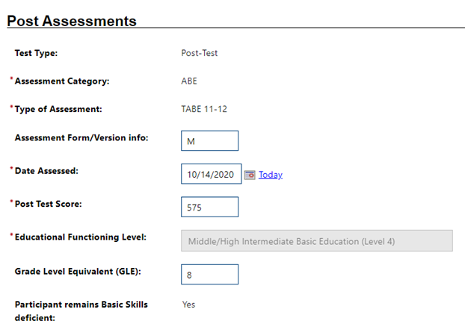
Recording Measurable Skill Gains in EmployRI
Entering Educational Functioning Level (EFL) Gains (ABE and ESL): EFL gains for ABE and ESL test scores are recorded in Staff Profile > Case Management Profile > Programs > Educational Functioning Level for Measurable Skill Gain bar.
Post-Test
Step 3:
In the expanded Post Assessment area, the Test Type, Assessment Category, and Type of Assessment will be pre-filled based on the Pre-Test.
NOTE that the Post-test Assessment Type and Assessment Form/Version must be the same as the Pre-Test in order for this to work.
Notes:
Slide 28: Recording Measurable Skill Gains in EmployRI
Entering Educational Functioning Level (EFL) Gains (ABE and ESL): EFL gains for ABE and ESL test scores are recorded in (file path)
Staff Profile > Case Management Profile > Programs > Educational Functioning Level for Measurable Skill Gain bar.
Step 3: In the expanded Post Assessment area, the Test Type, Assessment Category, and Type of Assessment will be pre-filled thanks to the information you entered for the pre-test.
PLEASE NOTE that the Post-test Assessment Type and Assessment Form/Version must be the same as the Pre-Test in order for this to work.

Slide 28
Recording Measurable Skill Gains in EmployRI
Entering Educational Functioning Level (EFL) Gains (ABE and ESL): EFL gains for ABE and ESL test scores are recorded in Staff Profile > Case Management Profile > Programs > Educational Functioning Level for Measurable Skill Gain bar.
Post-Test
Step 4: Enter the:
Date Assessed,
Post Test Score (scale score), and
Grade Level (if you do not enter the above information, the EFL increase will not be picked up)
The system will automatically set the Education Functioning Level and indicate if the participant remains deficient in basic skills based on the score.
Step 5: Click on “SAVE” to secure your edits.
Notes:
Slide 29: Recording Measurable Skill Gains in EmployRI.
Entering Educational Functioning Level (EFL) Gains (ABE and ESL): EFL gains for ABE and ESL test scores are recorded in (file path)
Staff Profile > Case Management Profile > Programs > Educational Functioning Level for Measurable Skill Gain bar.
Step 4: Enter the:
Date Assessed,
Post Test Score (scale score), and
Grade Level (if you do not enter the above information, the EFL increase will not be picked up)
The system will automatically set the Education Functioning Level and indicate if the participant remains deficient in basic skills based on the score.
Step 5: Click on “SAVE” to secure your edits.

Slide 29
Recording Measurable Skill Gains in EmployRI
Entering Educational Functioning Level (EFL) Gains (ABE and ESL): EFL gains for ABE and ESL test scores are recorded in Staff Profile > Case Management Profile > Programs > Educational Functioning Level for Measurable Skill Gain bar.
Post-Test
Step 6:
A Participant who is below post-secondary grade level at program entry and achieves a gain of at least one EFL on an acceptable Adult Basic Education (ABE) or English as a Second Language (ESL) post-test, will earn an EFL Measurable Skills Gain.
Notes:
Slide 30: Recording Measurable Skills Gains in EmployRI
Post Test
Step 6: A Participant who is below post-secondary grade level at program entry and achieves a gain of at least one EFL on an acceptable Adult Basic Education (ABE) or English as a Second Language (ESL) post-test, will earn an EFL Measurable Skills Gain.

Slide 30
Recording Measurable Skill Gains in EmployRI
Post-Secondary Transcript/ Report Card
Secondary Transcript/ Report Card
Training Milestone
Skills Progression
Educational Functioning Level (EFL)
(two ways)
ABE / ESL Test Scores
Entry into Post-Secondary Education
Notes:
Slide: 31 Educational Functioning Level
The second way to record an Education Functioning Level gain is to record a participant’s entry into postsecondary education. That process is a bit simpler…

Slide 31
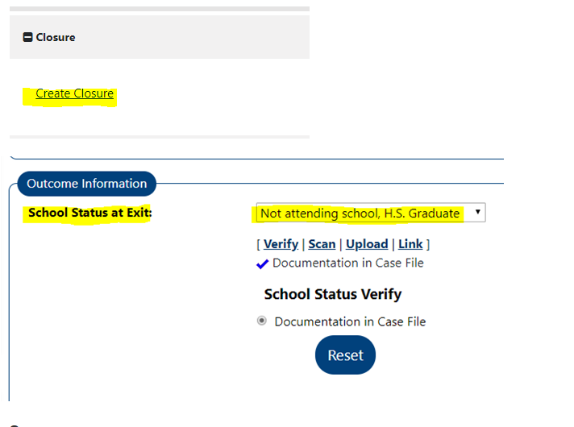
Recording Measurable Skill Gains in EmployRI
Entering Educational Functioning Level (EFL) Gains (Entering Post-Secondary Education): To record EFL Gains for exiters who received training/education services and enter Post-Secondary after exit:
Step 1:
In the WIOA Closure screen select “Not attending school, HS Graduate” in the “School Status at Exit” field. Be sure that you have proof of school status at exit in the customer file.
(NOTE: this field is not required for Adult/DW exiters, but must be entered to receive credit for the MSG.)
Notes:
Slide 32:
Entering Educational Functioning Level (EFL) Gains (Entering Post-Secondary Education): To record EFL Gains for exiters who received training/education services and enter Post-Secondary after exit:
Step 1: Once again, having brought up the participant’s case;
In the WIOA Closure screen select “Not attending school, HS Graduate” in the “School Status at Exit” field. Be sure that you have proof of school status at exit in the customer file.
(NOTE: this field is not required for Adult/DW exiters, but must be entered to receive credit for the MSG.)

Slide 32
Recording Measurable Skill Gains in EmployRI
Entering Educational Functioning Level (EFL) Gains (Entering Post-Secondary Education): To record EFL Gains for exiters who received training/education services and enter Post-Secondary after exit:
Step 2:
When creating a quarterly follow-up record, set the “Placement in Quarter” field to “Post-secondary Education”, indicate the date of placement in post-secondary, and indicate the documentation used to verify post-secondary enrollment.
(NOTE: The post-secondary placement must occur during the same program year as the qualifying training/education service to count as a MSG)
Notes:
Slide 32:
Later on; when creating a quarterly follow-up record, set the “Placement in Quarter” field to “Post-secondary Education”, indicate the date of placement in post-secondary, and indicate the documentation used to verify post-secondary enrollment. You will have completed Post Secondary After Exit Process.
NOTE: The post-secondary placement must occur during the same program year as the qualifying training/education service to count as a MSG)

Slide 33
Recording Measurable Skill Gains in EmployRI
Post-Secondary Transcript/ Report Card
Secondary Transcript/ Report Card
Training Milestone
Skills Progression
Educational Functioning Level (EFL)
(two ways)
Notes:
Slide 33: Now we’ll review how to record EVERY OTHER TYPE of Measurable Skill gain! No matter which of the four you are reporting, the process is the same:

Slide 34
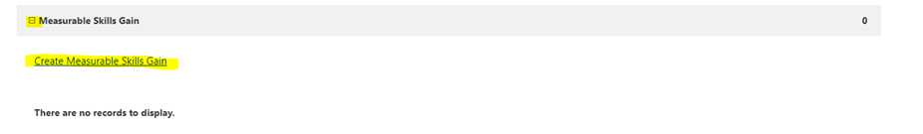
Recording Measurable Skill Gains in EmployRI
Recording non-EFL Skills Gains: All measurable skills gains other than EFL gains, are recorded in
Staff Profile > Case Management Profile > Programs > WIOA Measurable Skills Gains bar.
Step 1:
Click on the Measurable Skills Gains bar to expand it and then click on “Create Measurable Skills Gain”.
Notes:
Slide 34: Once again, having brought up the participant’s case; on the Measurable Skills Gains bar to expand it and then click on “Create Measurable Skills Gain”.

Slide 35
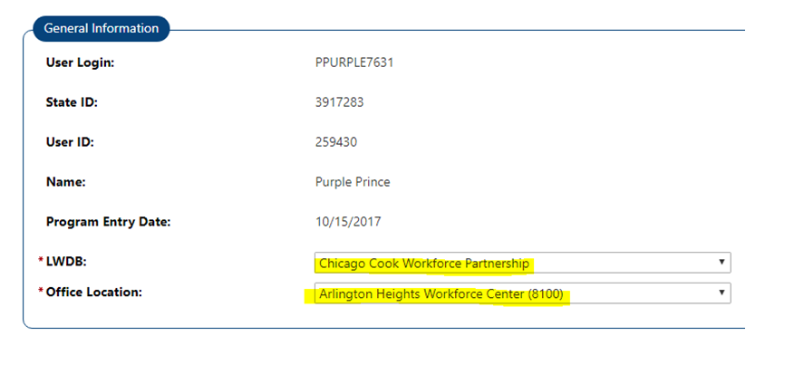
Recording Measurable Skill Gains in EmployRI
Recording non-EFL Skills Gains: All measurable skills gains other than EFL gains, are recorded in
Staff Profile > Case Management Profile > Programs > WIOA Measurable Skills Gains bar.
Step 2:
In the “General Information” section, select or confirm the LWDB and Office/Provider.
Notes:
Slide: 35 Step: 2 In the “General Information” section, select or confirm the LWDB and Office/Provider.

Slide 36
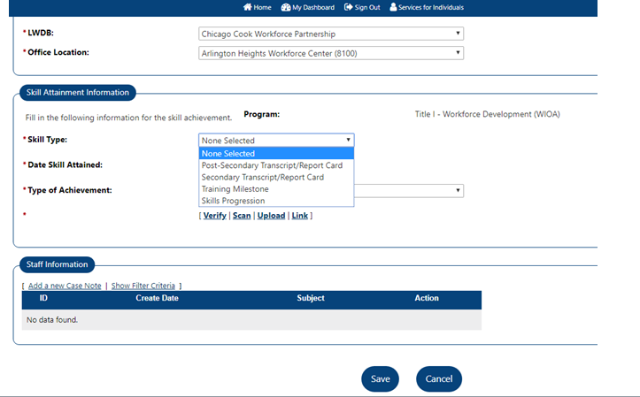
Recording Measurable Skill Gains in EmployRI
Recording non-EFL Skills Gains: All measurable skills gains other than EFL gains, are recorded in
Staff Profile > Case Management Profile > Programs > WIOA Measurable Skills Gains bar.
Step 3:
In the Skill Attainment Information, select the applicable Skill Type based on the descriptions and requirements outlined above.
Notes:
Slide 36
Step 3: In the Skill Attainment Information, select the applicable Skill Type based on the descriptions and requirements outlined above.

Slide 37
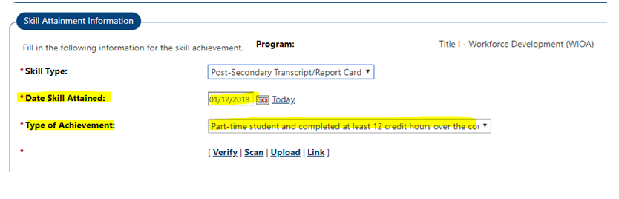
Recording Measurable Skill Gains in EmployRI
Recording non-EFL Skills Gains: All measurable skills gains other than EFL gains, are recorded in
Staff Profile > Case Management Profile > Programs > WIOA Measurable Skills Gains bar.
Step 4:
Add the date the Skill Gain was attained in the “Date Skill Attained” box.
Notes:
Slide: 37
Step 4: Add the date the Skill Gain was attained in the “Date Skill Attained” box.

Slide 38
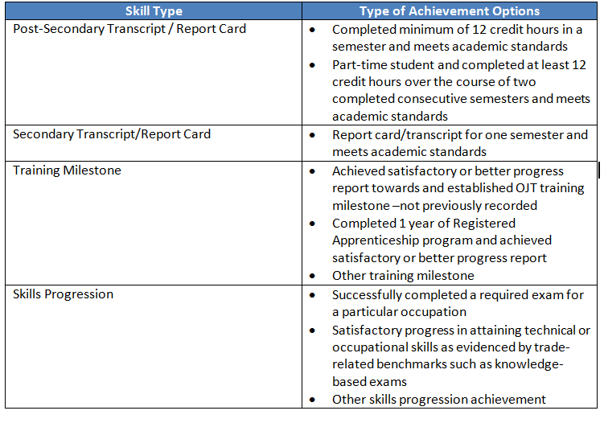
Recording Measurable Skill Gains in EmployRI
Recording non-EFL Skills Gains: All measurable skills gains other than EFL gains, are recorded in
Staff Profile > Case Management Profile > Programs > WIOA Measurable Skills Gains bar.
Step 5:
Select the “Type of Achievement” (see prior slide). Note that the Type of Achievement selections will vary depending on which Skill Type was selected in Step 2. The following table shows which Type of Achievements go with which Skill Types.
Notes:
Slide 38
Step 5: Select the “Type of Achievement” (see prior slide). Note that the Type of Achievement selections will vary depending on which Skill Type was selected in step 2. The above table shows which Type of Achievements go with which Skill Types.

Slide 39
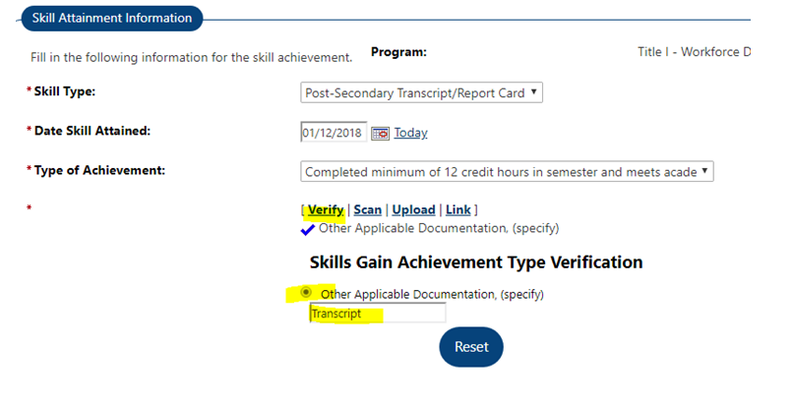
Recording Measurable Skill Gains in EmployRI
Recording non-EFL Skills Gains: All measurable skills gains other than EFL gains, are recorded in
Staff Profile > Case Management Profile > Programs > WIOA Measurable Skills Gains bar.
Step 6:
Click on “Verify” and select “Other Applicable Documentation, (specify). Type in the documentation used to verify the skills gain in the box. Then click on Upload or Scan and save a copy of the documentation.
Notes:
Slide: 39
Step 6: Click on “Verify” and select “Other Applicable Documentation, (specify). Type in the documentation used to verify the skills gain in the box. Then click on Upload or Scan and save a copy of the documentation. Then it is complete.

Slide 40

Office of Planning, Integrity and Compliance (OPIC)
We thank you for reviewing the second of a continuing series of technical assistance presentations by the Office of Planning, Integrity and Compliance.
The Office of Planning, Integrity and Compliance (also known as OPIC) is a newly constituted office that has absorbed a number of key functions related to the administration and oversight of the WIOA law.
Part of our focus will be to provide regular technical assistance and knowledge building opportunities to provide a more holistic understanding of the law, its regulations, and its requirements.
For more information and/or to access to OPIC’s technical assistance training presentations please refer to OPIC’s website below.
https://dlt.ri.gov/about-us/office-planning-integrity-and-compliance
Notes:
Slide: 40 Office of Planning, Integrity and Compliance (OPIC)
Office of Planning, Integrity and Compliance (also known as OPIC) is a newly constituted office that has absorbed a number of key functions related to the administration and oversight of the WIOA law.
Part of our focus will be to provide regular technical assistance and knowledge building opportunities to provide a more holistic understanding of the law, its regulations, and its requirements.

Slide 41
Measurable Skills Gains (MSG) Reporting
Office of Planning, Integrity, and Compliance
August 2023

